Slide 1
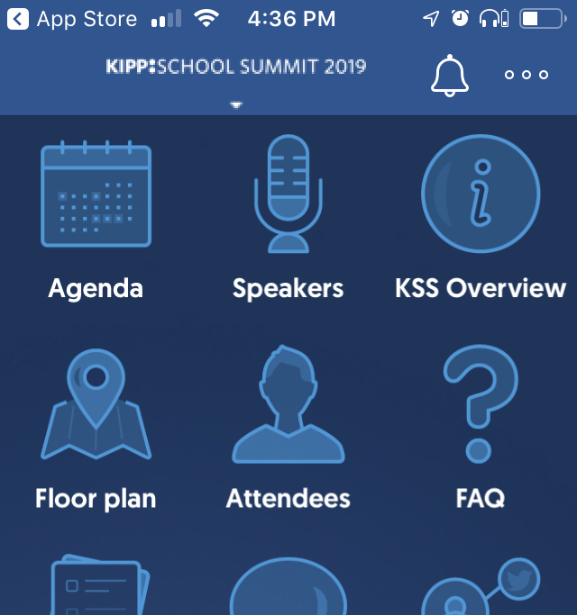
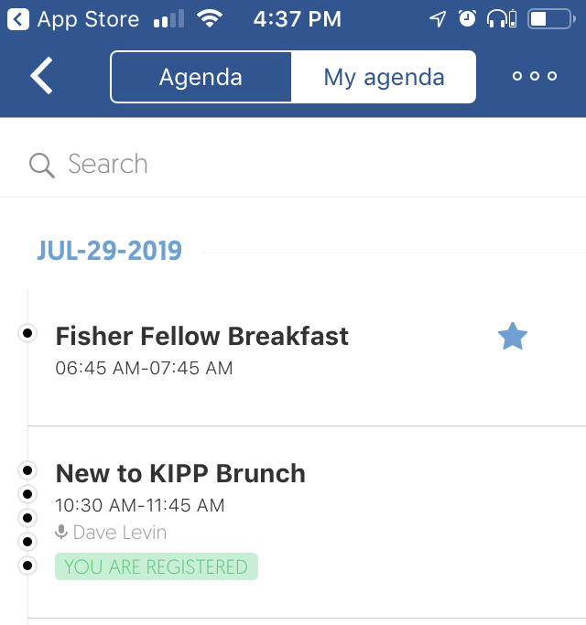
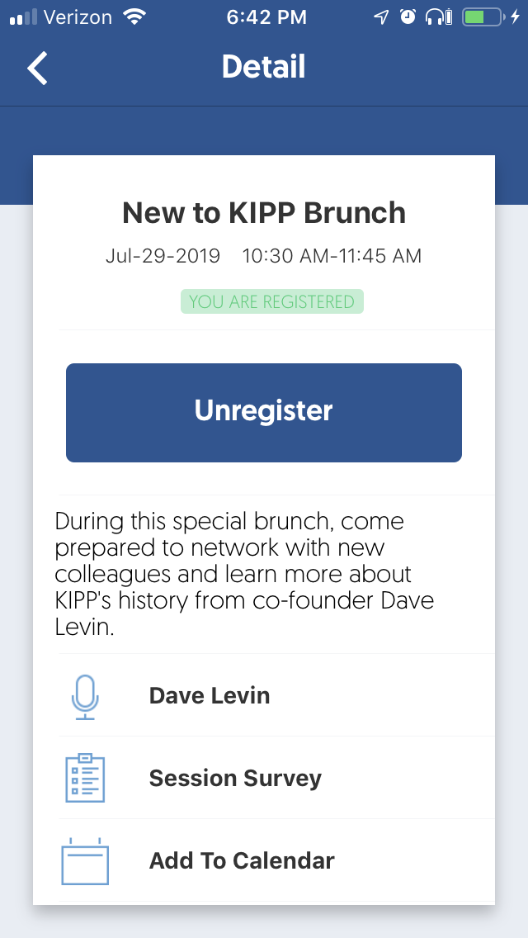
Survey Directions
1. Download the KSS Mobile App or from browser go to www.kipp.org/kssmobile
Search “Aventri Events” in the iOS App Store or Google Play Store. Event code: 536187. Username: your registration email address. Password: KIPP25
2. Select the “Agenda” Icon
3. Select “My agenda” or search for the session by typing in part of the session title.
4. Select the session and then select “Session Survey”

